Slide 1
Digital Portfolio
STUDENT NAME: VARSHA R
REGISTER NO AND NMID: E49BE6354E9DCF8AC5E47AABF0DEA10E
DEPARTMENT: BSC COMPUTER SCIENCE
COLLEGE: SRI AKILANDESWARI WOMEN’S COLLEGE
UNIVERSITY : THIRUVALLUVAR UNIVERSITY

Slide 2
PROJECT TITLE
STUDENT DIGITAL PORTFOLIO
USING FRONT-END DEVELOPMENT

Slide 3


AGENDA
Problem Statement
Project Overview
End Users
Tools and Technologies
Portfolio design and Layout
Features and Functionality
Results and Screenshots
Conclusion
Github Link
3/21/2024 Annual Review

Slide 4

PROBLEM STATEMENT
In today's competitive academic and professional landscape, students often struggle to effectively showcase their skills, projects, and achievements in a single, accessible format. Traditional resumes and cover letters are limited, often failing to capture the full scope of a student's technical abilities, creative work, and personal growth. The challenge is to create a dynamic, centralized platform that goes beyond a static document to present a comprehensive, compelling narrative of a student's journey and capabilities to potential employers, academic institutions, and collaborators.

Slide 5

PROJECT OVERVIEW
The "Student Digital Portfolio" is a personal website designed to serve as a comprehensive online resume and showcase for a Computer Science student named Varsha R. It's built as a static web page using core web technologies. The project's goal is to present the student's academic background, technical skills, project experience, and personal interests in a visually appealing and organized manner. By consolidating all this information, the portfolio provides a single point of reference for anyone interested in her work, demonstrating her abilities in a practical, real-world application.

Slide 6

WHO ARE THE END USERS?
The primary end users for this digital portfolio are:
Potential Employers: Recruiters and hiring managers in the tech industry looking for junior developers or interns.
Academic Institutions: College admissions officers or faculty members reviewing applications for higher studies or scholarships.
Collaborators & Peers: Other students or professionals who might be interested in collaborating on projects or networking.
General Audience: Anyone interested in viewing Varsha's work and learning about her journey.

Slide 7

TOOLS AND TECHNIQUES
The project was built using the following tools and technologies:
HTML (Hyper Text Markup Language): Used for the basic structure and content of the web page, including sections for About, Education, Skills, Projects, and more.
CSS (Cascading Style Sheets): Used for styling the website to control its layout, colors, typography, and visual design. It includes a responsive design to ensure the site looks good on various devices.
JavaScript: Used to add interactive features, such as the typing animation in the header and the smooth scrolling navigation, which enhances the user experience.
Code Editor: A text editor like Visual Studio Code, Sublime Text, or Atom was used for writing and organizing the code.
Web Browser: Used for testing and viewing the website locally.
GitHub: An online platform used for version control and hosting the project's source code, making it accessible to others and demonstrating Git skills.

Slide 8
POTFOLIO DESIGN AND LAYOUT
The portfolio is divided into several logical sections, including:
Header: Features the student's name and a dynamic, engaging typing animation.
Navigation Bar: Provides quick access to all sections of the portfolio.
About Me: A concise introduction with a profile picture.
Education & Experience: Presented using a clear timeline layout to show the progression of academic and professional history.
Skills: A grid-based layout for listing technical skills, with hover effects for a modern touch.
Projects: A dedicated section to highlight key projects with brief descriptions.
Achievements & Hobbies: Separate sections to showcase accomplishments and personal interests, providing a more holistic view of the individual.
Contact Form: An interactive form for direct communication.
8

Slide 9
FEATURES AND FUNCTIONALITY
The website includes the following key features:
Responsive Design: The layout adjusts automatically to fit different screen sizes, from desktops to mobile phones, ensuring a consistent user experience.
Interactive Header: A JavaScript-powered typing effect adds a dynamic and engaging element to the page, introducing the student in a creative way.
Smooth Scrolling Navigation: Clicking on a navigation link smoothly scrolls the page to the corresponding section, improving navigation ease.
Contact Form: A basic, client-side contact form with validation, which provides a confirmation message upon submission.
Hover Effects: Subtle visual feedback on skills and navigation links, making the site feel more polished and professional.

Slide 10

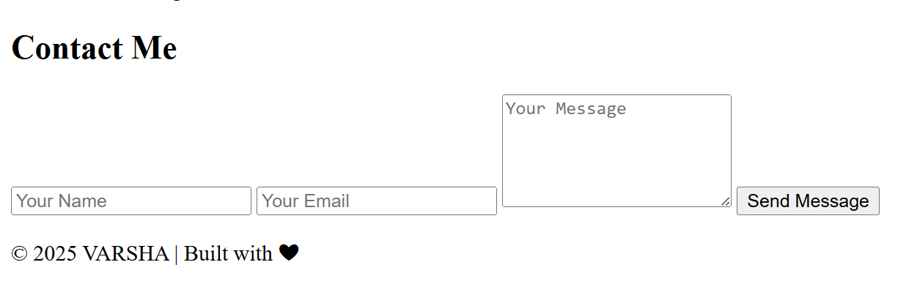
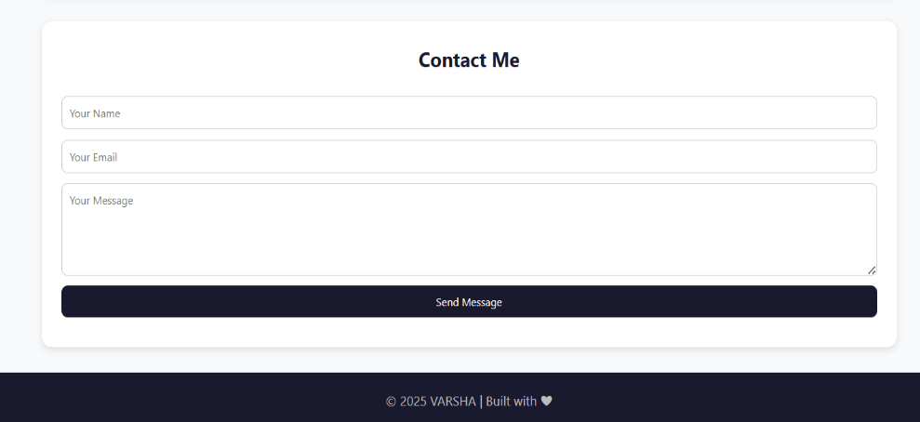
RESULTS AND SCREENSHOTS
The result is a fully functional, single-page digital portfolio that is easy to navigate and effectively communicates Varsha's skills and experience. The design is clean and professional, successfully replacing a traditional resume with a more interactive and detailed presentation of her work.
BEFORE ADDING CSS AND JAVASCRIPT
AFTER ADDING CSS AND JAVASCRIPT
3/21/2024 Annual Review
10

Slide 11
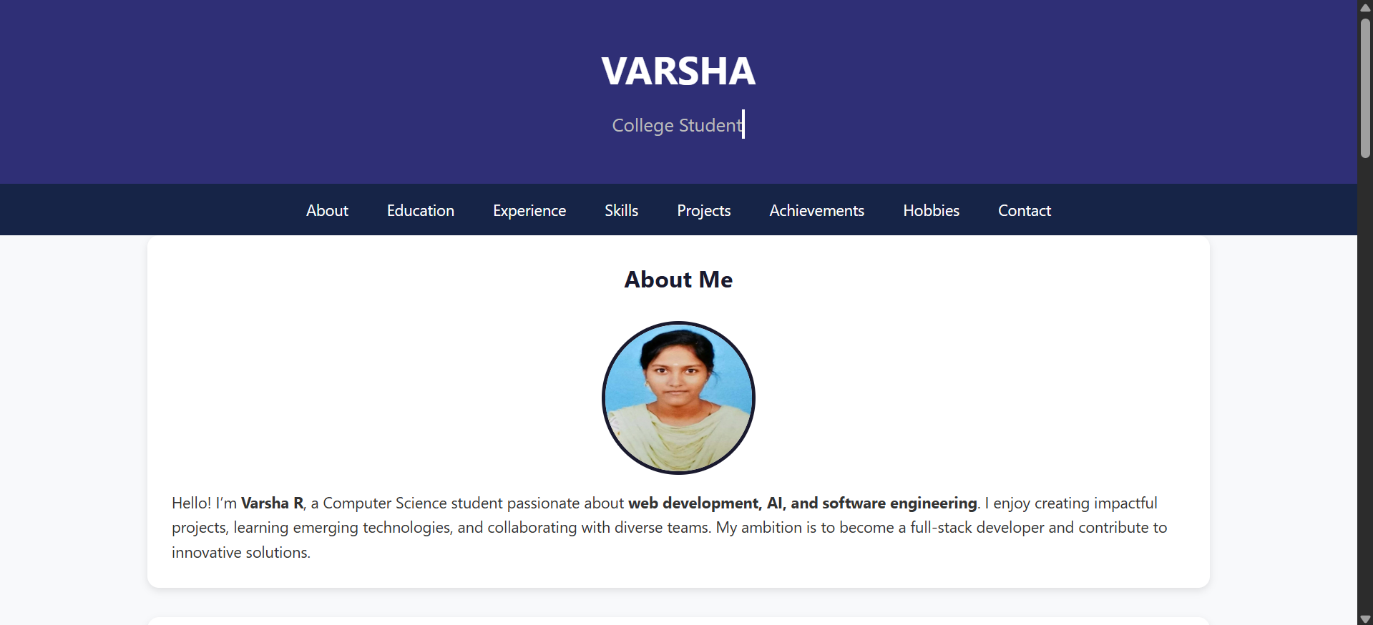
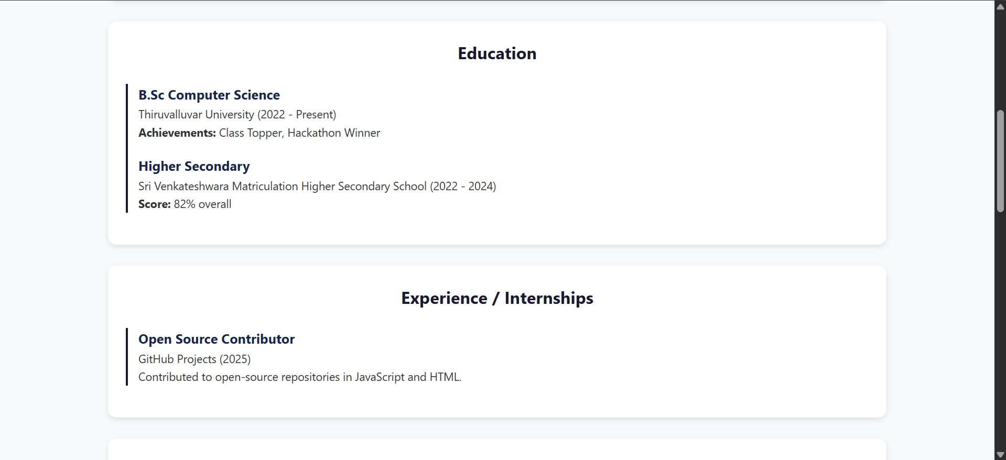
SCREENSHOTS

Slide 12
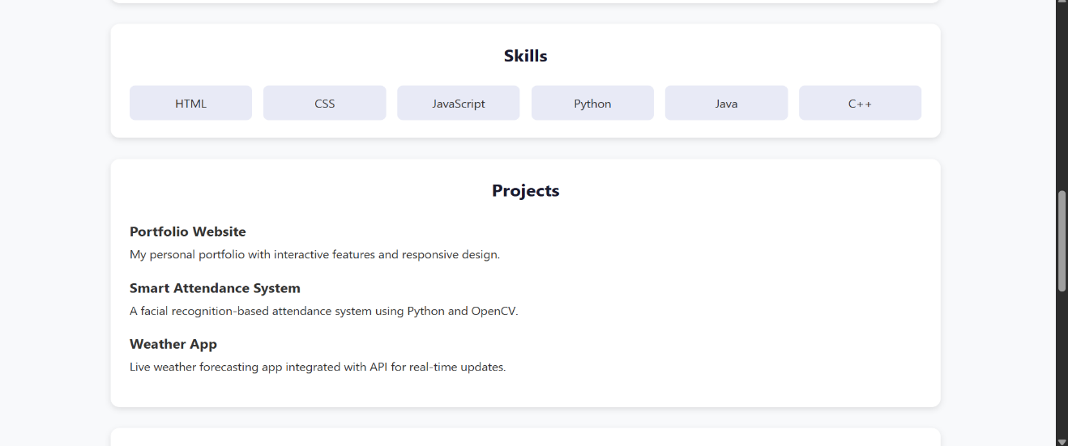
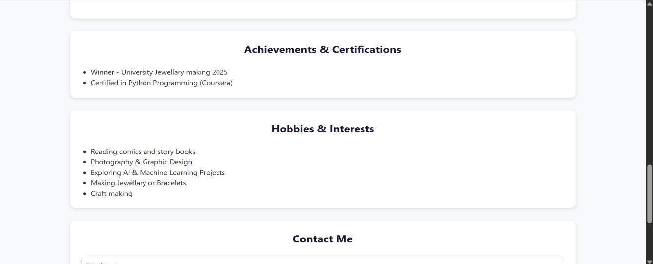
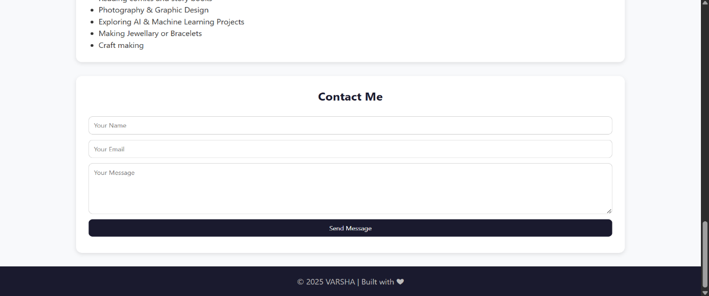
SCREENSHOTS

Slide 13
CONCLUSION
The "Student Digital Portfolio" project successfully achieves its objective of creating a dynamic and professional online presence. It serves as a powerful tool for self-promotion, allowing Varsha to showcase her technical skills and accomplishments in a format that goes beyond the limitations of a standard resume. The project itself demonstrates proficiency in HTML, CSS, and JavaScript, while its content highlights her capabilities in various other programming languages and domains. This portfolio is a valuable asset for her career development, serving as a live example of her abilities and a central hub for her professional identity.
13

Slide 14
GITHUB
The source code for this project is available on GitHub, where it can be viewed and cloned for review. The repository serves as a clear demonstration of version control skills and provides a transparent look into the project's development.
https://github.com/Varsha-Ramesh17/TNSDC-FWD-Digitalportfolio.git

